Slide 1

Physical Layer Data Augmentation Techniques for Face Recognition and Face Emotion Classification
Ashish Vinodkumar Pranav Manjunath
Duke University
Notes:
Ashish

Slide 2
Objectives
To build a Deep Learning Model that can accurately detect faces and predict face emotions.
Understand if adding physical layer augmentation techniques to train a Deep Learning Model will help improve model performance, while reducing the number of pixels used.
Compare the model results for various physical layer augmentation techniques and conclude which technique performs the best when predicting Face Emotions.
Notes:
Ashish

Slide 3
Abstract
We explored various physical layer augmentation techniques such as top-half mask, bottom-half mask, one-fourth mask on the Face Emotion Classification Dataset.
We used a VGG-16 model architecture for Face Emotion Classification.
We further used the following metrics to assess performance:
Accuracy
Precision
Recall
F1 Score
Notes:
Ashish

Slide 4
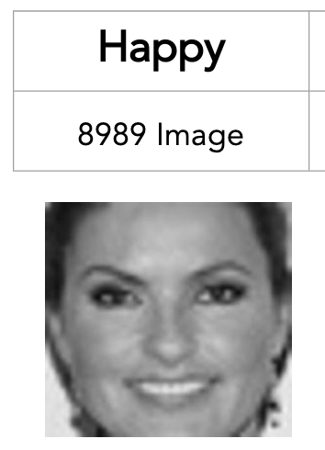
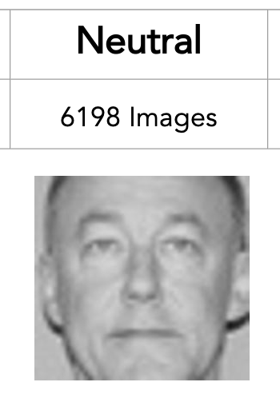
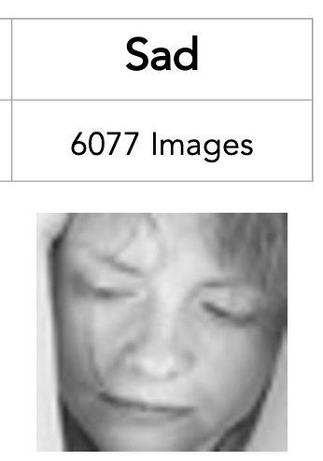
Data Source
Took a subset of the “Face expression recognition dataset” by Jonathan Oheix on Kaggle. Consists of only grayscale (black-and-white) images.
Notes:
Pranav

Slide 5
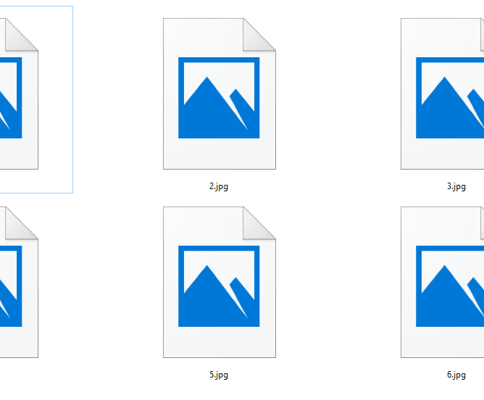
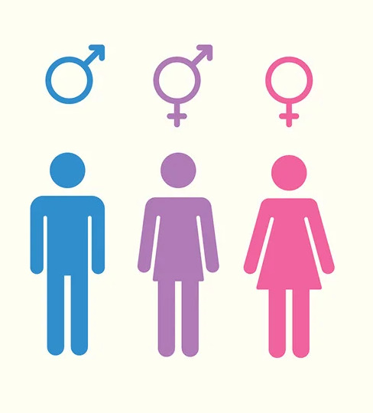
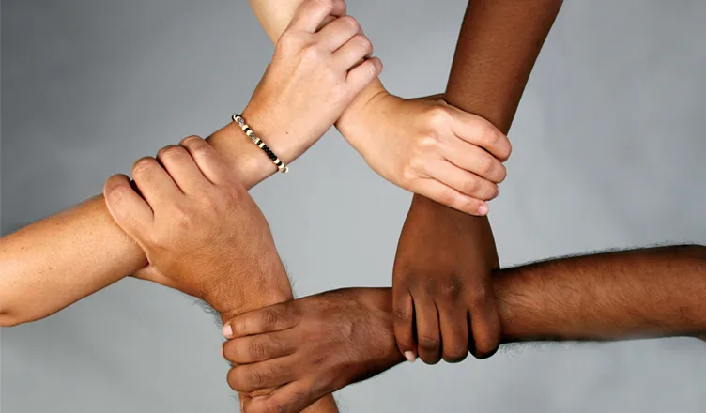
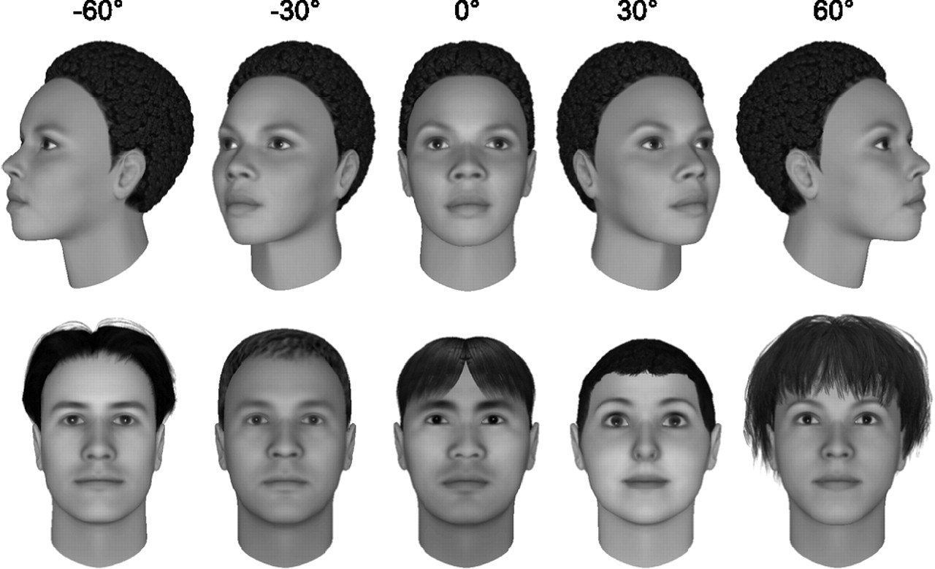
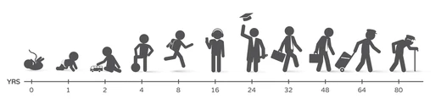
Tackling Data Bias
At least 5000 images
Gender
Races
Face Views
Age
Notes:
Pranav

Slide 6

Methodology
fd
Image
Face Detection
Physical Masks
Face Emotion Classifier
Predictions
Haar Feature based OpenCV Cascade Classifier
Bottom Mask
Top Mask
One Fourth Mask
Custom VGG-16 Model
VGG-16
Happy
VGG-16
Happy
VGG-16
Happy
Notes:
Pranav

Slide 7

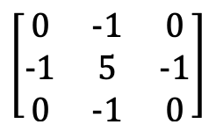
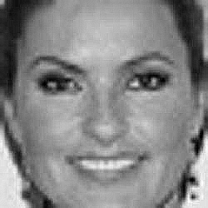
Data Augmentation for Emotion Classification
Utilized a sharpness kernel to improve the model classification accuracy.
Original Image
Sharpened Image
Notes:
Ashish

Slide 8
Data Pipeline
Training Split (80%): 7191 Images
x2 (Data Augmentation
Happy
(8989 Images)
Testing Split (20%): 1798 Images
Training Split (80%): 4958 Images
x2 (Data Augmentation
All Images
(21,264 Images)
Neutral
(6198 Images)
Testing Split (20%): 1240 Images
Sad
(6077 Images)
Training Split (80%): 4862 Images
x2 (Data Augmentation
Testing Split (20%): 1215 Images
Notes:
Ashish

Slide 9
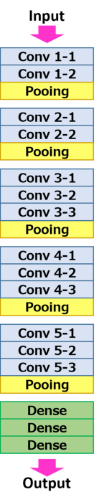
VGG -16 Model
Filters =64
Kernel = (3,3)
Filters =128
Kernel = (3,3)
Filters =256
Kernel = (3,3)
Optimizer: Adam
Learning Rate: 0.0001
Loss: Sparse Categorical Cross Entropy
Batch Size: 64
Filters =512
Kernel = (3,3)
Filters =512
Kernel = (3,3)
4096 Units
4096 Units
1000 Units
Notes:
Ashish

Slide 10




Hyper Parameters We Experimented With
dd
We decided to use a VGG-16 Model with the following hyperparameters:
Learning Rate: 1e-3, 1e-4, 1e-5
L2 Regularization: 1e-4, 1e-3, 1e-5
Dropout: 0.05, 0.5, 0.6, 0.7
For Physical Layer Augmentation Techniques, we implemented the following:
Top-Half Mask
Bottom-Half Mask
One-Fourth Mask
Original Image
Top-Half Mask
Bottom-Half Mask
One-Fourth Mask
Notes:
Ashish

Slide 11
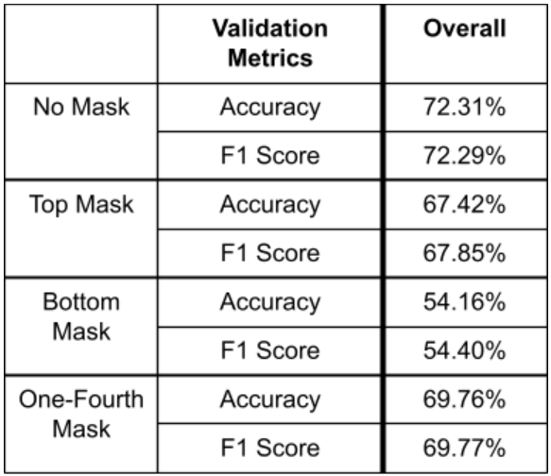
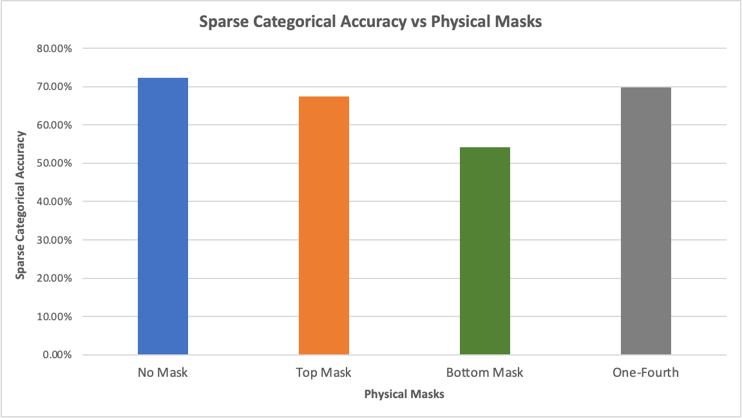
Results
(Baseline)
1
3
4
2
Notes:
Ashish

Slide 12
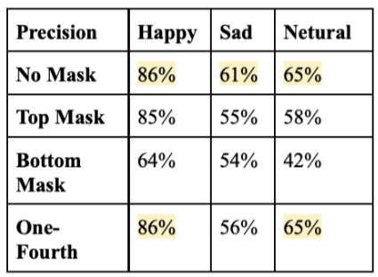
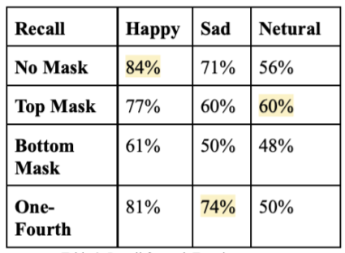
Results (cont’d): Precision & Recall
Precision
Recall
1
3
4
2
Notes:
Pranav

Slide 13
Conclusion
We can remove ¼ pixels and still achieve near baseline accuracy.
Each masked model performs the best when predicting the emotion Happy.
As expected, the model performance indicates that the forehead is not extremely important while predicting face emotions.
More importantly, the bottom half of the face is critical in predicting these facial emotions.
Notes:
Pranav

Slide 14

Flask Web-App
Home Page
Notes:
Pranav

Slide 15
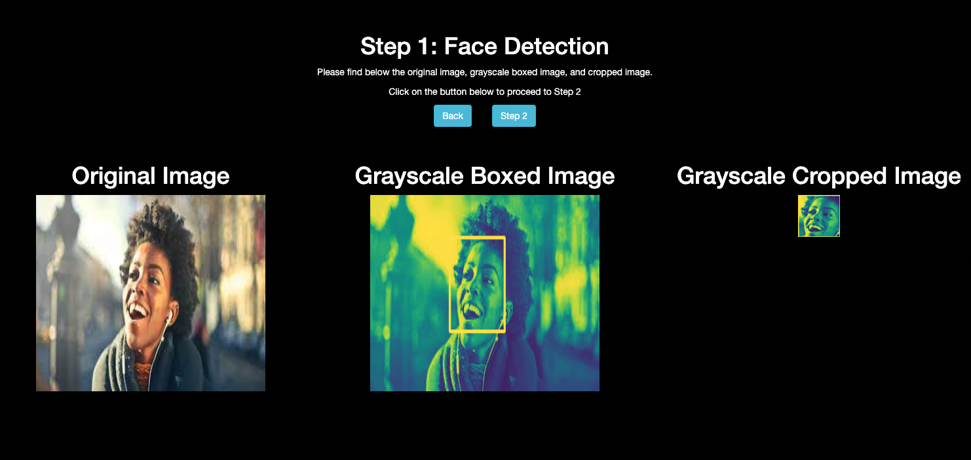
Step-1 Face Detection
Notes:
Pranav

Slide 16
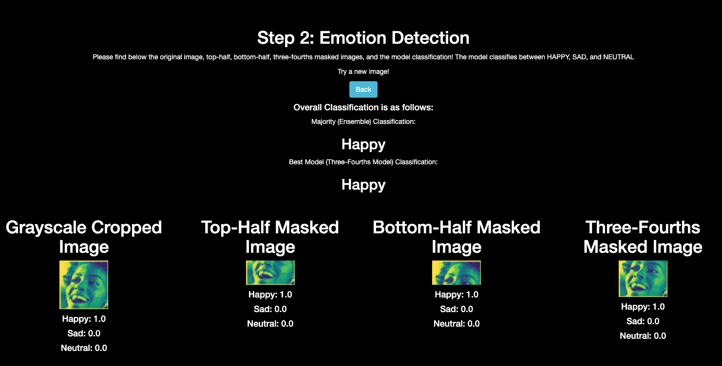
Step-2 Emotion Detection
Notes:
Ashish

Slide 17
Step-2 (cont’d) Emotion Detection Classification
Best-Model Classification
One-Fourth Mask Model
Majority Ensemble Voting Classification
Pools the classification results from baseline (no-mask), top-half mask, bottom-mask, and one-fourth mask models.
Votes on the majority classification, to identify winning label.
In case of tie, the best model classification is used as a tiebreaker.
Notes:
Ashish

Slide 18

References
1. Pei, Zhao, et al. “(PDF) Face Recognition via Deep Learning Using Data Augmentation Based on Orthogonal Experiments.” ResearchGate, https://www.researchgate.net/publication/336061375_Face_Recognition_via_Deep_Learning_Using_Data_Augmentation_Based_on_Orthogonal_Experiments.
2. Li, Jessica. “Labelled Faces in the Wild (LFW) Dataset.” Kaggle, 17 May 2018, https://www.kaggle.com/jessicali9530/lfw-dataset.
3. Oheix, Jonathan. “Face Expression Recognition Dataset.” Kaggle, 3 Jan. 2019, https://www.kaggle.com/jonathanoheix/face-expression-recognition-dataset/discussion/152419.
4. “Cascade Classifier.” OpenCV, https://docs.opencv.org/3.4/db/d28/tutorial_cascade_classifier.html.
5. Porcu, Simone, et al. Evaluation of Data Augmentation Techniques for Facial ... https://www.researchgate.net/publication/345940392_Evaluation_of_Data_Augmentation_Techniques_for_Facial_Expression_Recognition_Systems.
6. Vepuri, Ksheeraj Sai, "Improving Facial Emotion Recognition with Image processing and Deep Learning" (2021). Master's Projects. 1030.
7. Wu, Shengbin. “Expression Recognition Method Using Improved VGG16 Network Model in Robot Interaction.” Journal of Robotics, Hindawi, 20 Dec. 2021, https://www.hindawi.com/journals/jr/2021/9326695/.
Notes:
Ashish

Slide 19
Thank You!
Notes:
Ashish

